Slide 1
Practice on Essential Enterprise Architecture Tool
001
Opening and Introduction

Slide 2
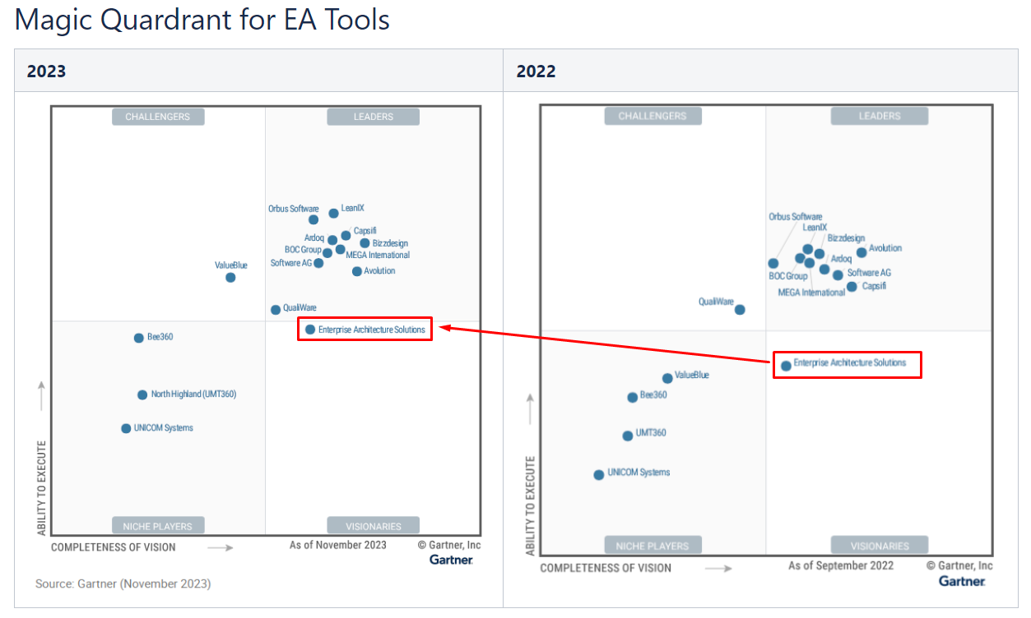
Positioning of Essential

Slide 3

Essential Open-Source Packages Download and Installation
002
https://enterprise-architecture.org/products/essential-open-source/essential-os-download/

